Slide 1
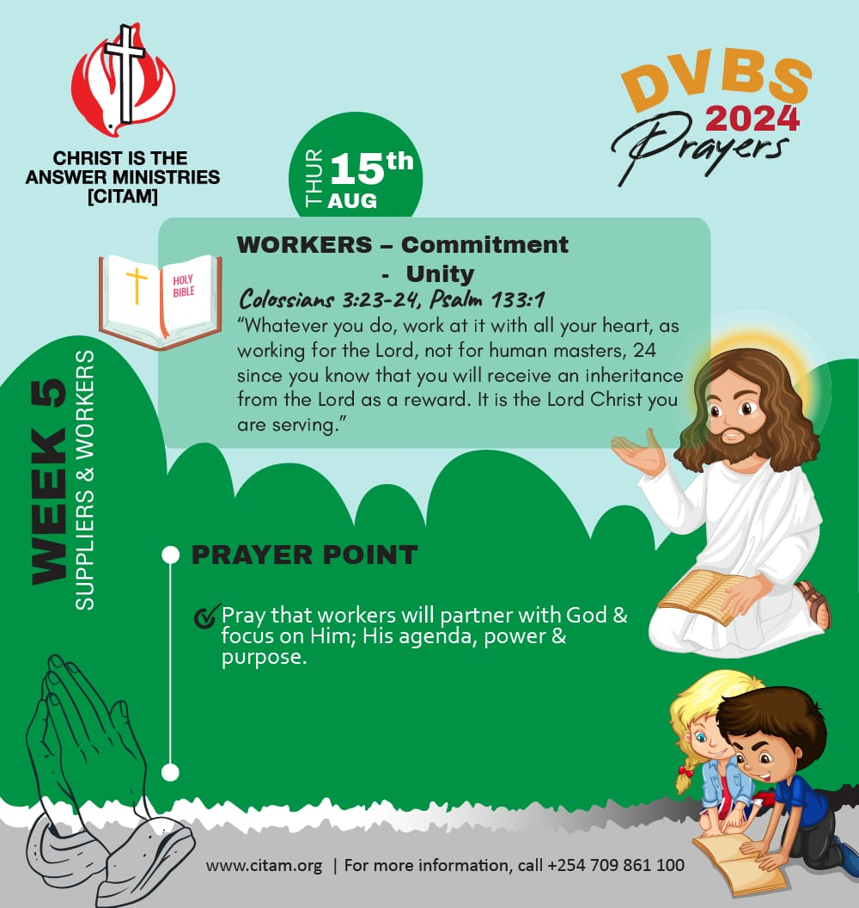

Morning Session #DVBS2024
(15th august)

Slide 2


Memory Verse
1
Isaiah 54:13,
¹³All thy children shall be taught of the Lord: and great shall be the peace of thy children.

Slide 3

THE CALL
2
Psalms 37:4
⁴Delight yourself in the LORD, and he will give you the desires of your heart.
Colossians 3:23-24-23
²³Whatever you do, work at it with all your heart, as working for the Lord, not for human masters, ²⁴since you know that you will receive an inheritance from the Lord as a reward. It is the Lord Christ you are serving.

Slide 4

Meditation
3
Psalms 127:3-7
Behold, children are a heritage from the LORD, the fruit of the womb a reward. ..He shall not be put to shame when he speaks with his enemies in the gate.
Matthew 21:16,
16"Do you hear what these children are saying?" Jesus said, "Yes, I hear them. And haven't you read in God's Word, 'From the mouths of children and babies I'll furnish a place of praise?’”
Matthew 18:10
10“Take heed that ye despise not one of these little ones; for I say unto you that in Heaven their angels do always behold the face of My Father who is in Heaven.

Slide 5

(Including today’s lesson) Declarations
4
Empowered by the Holy Spirit
John 16:13
“When the Spirit of truth comes, he will guide you into all the truth, for he will not speak on his own authority, but whatever he hears he will speak, and he will declare to you the things that are to come” (ESV).
Children​
Workers
Psalm 133:1
How good and pleasant it is when brothers live together in unity

Slide 6


^{Matthew 28:19}
5
¹⁹ Therefore go and make disciples of all nations, baptizing them in the name of the Father and of the Son and of the Holy Spirit, ²⁰ and teaching them to obey everything I have commanded you. And surely I am with you always, to the very end of the age.”

Slide 7
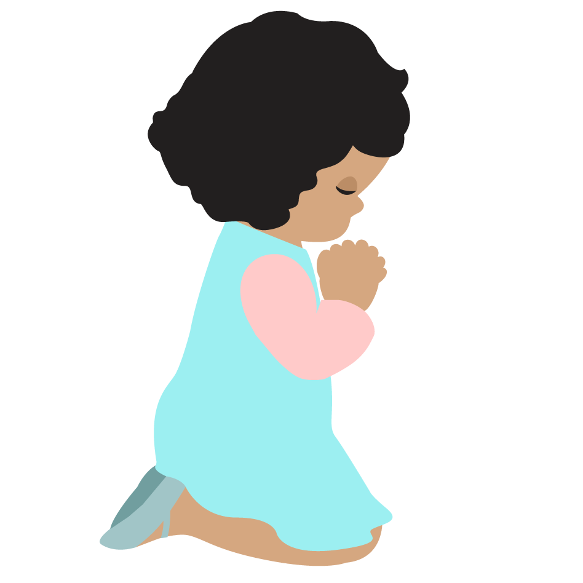
Thank you

